Slide 1
Student Success – Diversity, Inclusion, & Pathway Partnerships Through Change
Angelo Markantonakis – Associate VP of Academic Programs
Daryle Adams – Director of CTE, STEM, & ESL
Kelli Antonides – Director, Career & College Promise Programs

Slide 2
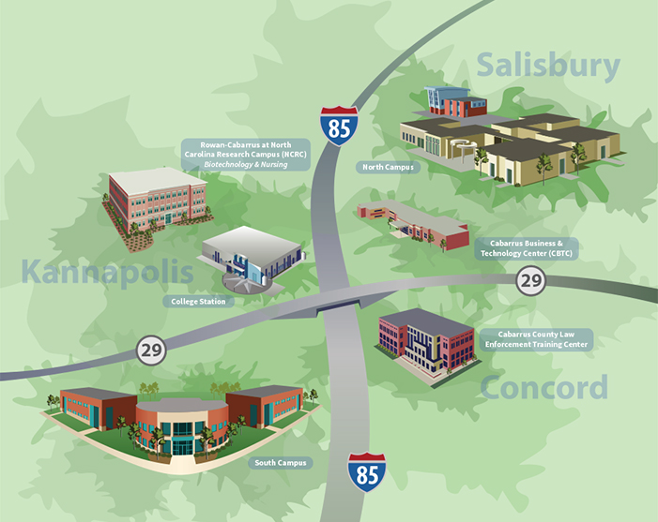
Overview of Rowan Cabarrus Community College
Founded…
Campus locations…
Population/Student Demographics…
Marketing Enrollment story…
Programs/Transfer…
AM

Slide 3
Why are we here?
Goals
Combatting our challenges with diversity
Funding
Dual enrollment successes & lessons
Establishing cultural capital
Recurring meetings & communication
Interventions
AM

Slide 4
Activity
4 Corners
The past is the past and we have to move forward to make change.
As educators and administrators, you control student pathways and influence decisions.
Change is a top down process that begins with the support of administration.
All students have equal access and equal opportunity to successfully pursue an education.
DA

Slide 5
Kannapolis City Schools
KCS Beliefs
We are gatekeepers and can remove barriers and create a different path forward.
We must commit to examining our history in order to fully understand institutional and structural racism.
We must hold ourselves accountable in areas where change is needed.
We must seek conversation outside of our comfort zone.
ALL of our students deserve inclusive, high-quality education in a safe environment where they feel respected, supported and are given every opportunity to succeed.
DA

Slide 6
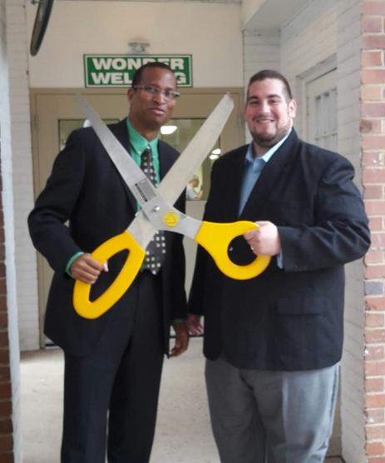
Building Partnerships
AM

Slide 7
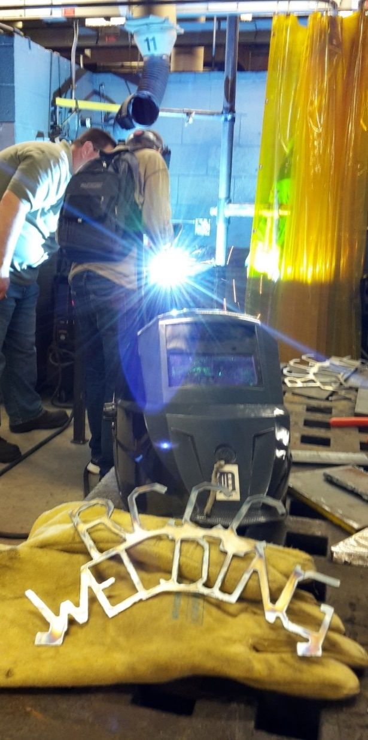
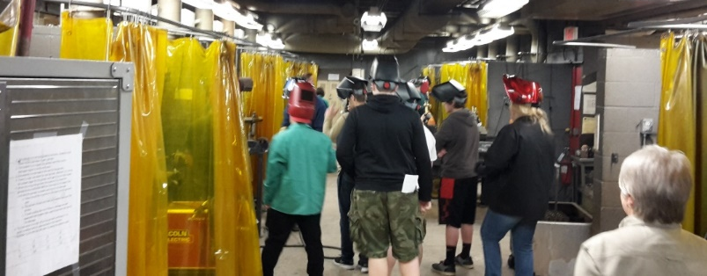
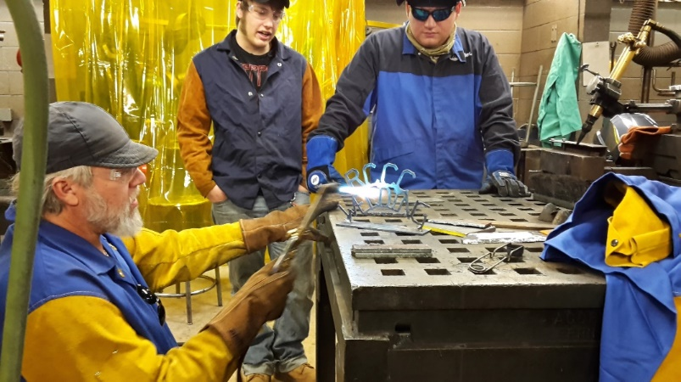
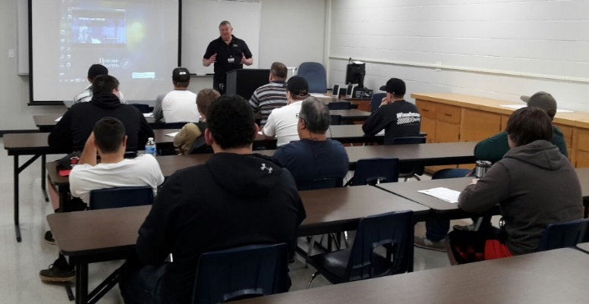
KA

Slide 8
KCS demographics
DA

Slide 9
Pathways to success
3 dual enrollment pathways offered on-site at high school
Welding, Information Technology, & Advertising & Graphic Design
Eliminate transportation barriers
Tuition & textbooks are free to students
Pathway successes
KA

Slide 10
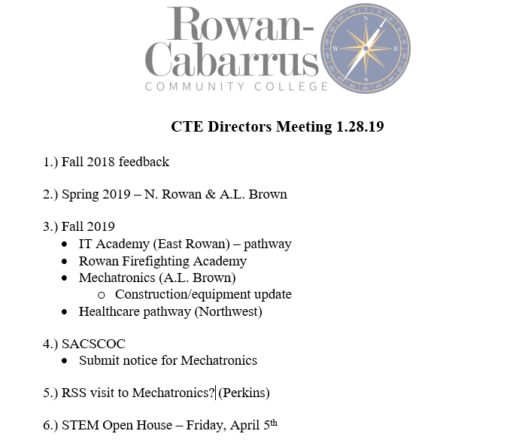
Framework for Success
KA

Slide 11
Student Success in Action
Growth in state’s dual enrollment program, Career & College Promise
62 (2013) -> 1192 (2019)
Ways we are addressing diversity amidst growth:
Growth of course offerings offered on-site at high schools
Multiple college orientations both at RCCC & high schools
Technology assistance on-site at each high school
Monthly meetings with KCS
Ensuring diversity within classes
A&K
Notes:
4/6 minority in Adversiting GRD

Slide 12
Lessons Learned
Challenges of Information Technology
Misidentified students
Initial pathway (mobile apps) was too advanced for students/underprepared. We had to go back to see how we could best meet the needs of students where they were.
Soft skills development
FERPA
KA
Notes:
Misidentified students at the HS level who had the pre-requisites needed for IT, but are minority/historically underrepresented students who didn’t have the skills to be successful in the course. HS had to go back and re-evaluate how they identified students.

Slide 13
Considering Cultural Capital
What are some examples of cultural capital that go further than money when it comes to a student’s educational pursuit?
What challenges does cultural capital present to your schools? What are you doing to overcome these challenges?
Challenges at Rowan-Cabarrus…
How to register
Parent night
Orientation
Technology login
FERPA
Money for equipment
Textbooks
Consumables
A&D

Slide 14
Questions?
Angelo Markantonakis: angelo.markantonakis@rccc.edu
Daryle Adams: daryle.adams@kcs.k12.nc.us
Kelli Antonides: kelli.Antonides@rccc.edu

